Slide 1
Tutorial 7
T03/08
Goh Rui Zhi
gohruizhi@u.nus.edu

Slide 2
Announcements
Assignment 2 is released!
Due 17th Nov 23:59hrs
Looks very different from what I’ve done…
Mainly focused on Web Security and Secure programming (Please read up!)
Any issues please direct them to the assignment TAs or use the forums!

Slide 3
Announcements
Please start forming teams for your Group Presentation!
3-4 students per team (3 x 4pax and 2 x 3pax would be ideal)
Please reply in the forum thread with your:
Team member names
Chosen Topic (Can be self-proposed, but let me know before replying)
Preferred Timeslot (Among the available) (Each timeslot is 20mins)
Timeslot is on a FCFS basis
Max 3 slots per week
Encouraged to present sooner (week 12) rather than later
Deadline for signup: Wednesday (27th Oct) 23:59

Slide 4
Group presentation rubrics
Sufficient technical content: 1 mark
Clarity of slides: 1 mark
Presentation + Q&A: 2 marks
Extras: 1 mark
Diagrams/Animations
Demo (If applicable)
Total 5% of your grade

Slide 5

Network Security

Slide 6
Recap - Firewalls
You need to configure firewall rules in the firewall table of each deployed firewall. Each rule occupies a row in the table. The fields of each rule, together with their possible values, are as follows:
No: Rule id
Src/Dst IP: Source/Destination IP (Can be single/range)
Src/Dst Port: Source/Destination Port
Protocol: Network protocol used
Direction: In/Out (Take note of the direction of traffic)
Action: Allow/Block

Slide 7
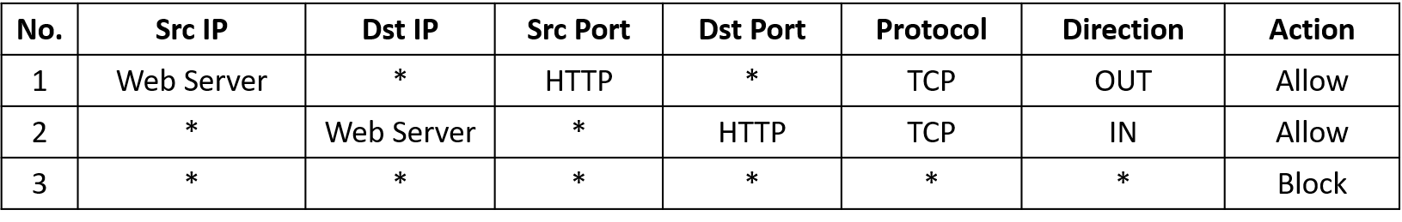
Recap - firewalls
Similar to the explanation given in the lecture notes, when a packet arrives, the action of the first rule that matches the packet applies. For example, the following three rules:
Important notes:
‘*’ means any
Remember traffic goes both ways. So usually one type of connection will have 2 rules (in and out)
Specific rules first (Usually for exception cases), generic rules next
Always put the block all at the end of the rules. If not, packets that are not previously drop will be allowed (Security risk)

Slide 8
Question a1
Suppose you are the system administrator of a new secondary school, and your first task is to design the school's network and its firewalls. You have decided to have 2 firewalls to protect your network.
The machines in the network include:
(a) Lab: Prepare report, search on web, network printers
(b) Teachers: Enter grades, send/receive emails, network printers
(c) Web-server: the school's Web server.
(d) Email-server: the school's SMTP email server.
(e) SQL-server: Student’s database

Slide 9
Question a1 - Requirements
(a) It is important to prevent cases where student exam questions get mistakenly printed in the Lab.
(b) It is also important to protect the SQL server.
(c) We know that source IP addresses can be spoofed. The school is worried that some students are running some hacking tools that generate spoofed source IP addresses. Hence, the school wants to block outbound packets from the school that do not have legitimate source IP addresses.

Slide 10




Question a1
Do you think the partition of the networks below is reasonable, and the given firewall rules below are appropriate for the school’s need?
Internal Network
DMZ (Demilitarized zone)
// The exposed network portion to the external network
Teachers
// Usually used for providing service
F2
F1
IN
OUT
IN
OUT
Teacher-printers
OUT
Internet
SQL-Server
Web-Server
Email-Server
Lab
Lab-printer

Slide 11
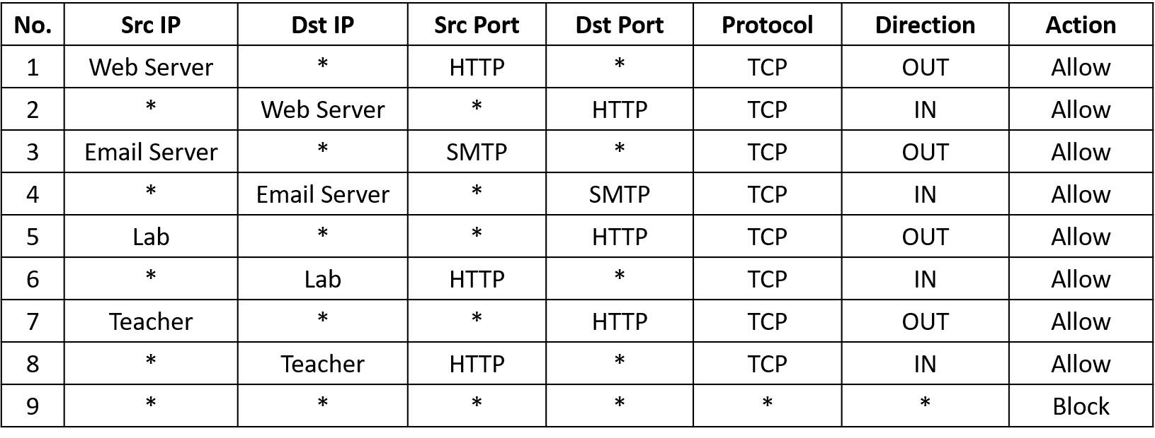
Question A1
Rules for firewall 1, F1 (Outermost firewall)

Slide 12
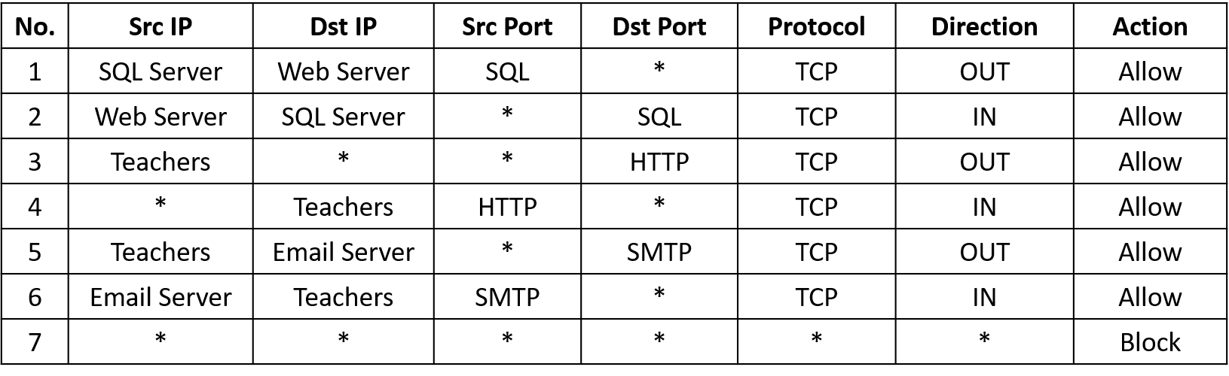
Question A1
Rules for firewall 2, F2 (Innermost firewall)

Slide 13
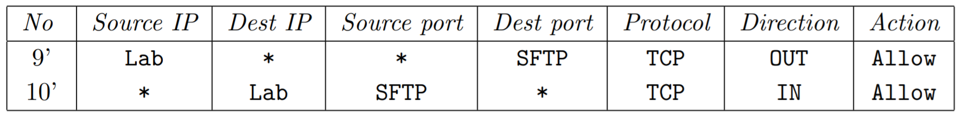
Question A1
Rules looks pretty reasonable ☺
(a) Which rule(s) allow Teachers to access external web services?
F1 rules 7 & 8, F2 rules 3 & 4
(b) Which rule(s) block Lab from accessing an external SMTP server?
F1 rule 9 (Block all that wasn’t allowed)
(c) What rules should you additionally set if you want to allow Lab to access external SFTP servers?

Slide 14
Question A2
The lecture notes list a few types of firewall. The firewalls above inspect only a few important fields of network packets. Which type of firewall do they belong to?
1. Packet filtering firewall (Main focus)
2. Stateful inspection firewall
3. Application-level gateway (aka Proxy firewall)
What we just see is the packet filtering firewall in action
Filters packet based on packet header information (E.g. IP address & Port number)

Slide 15
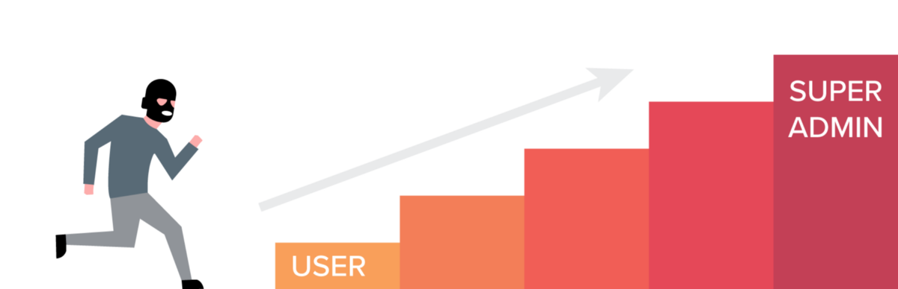
Privilege escalation

Slide 16
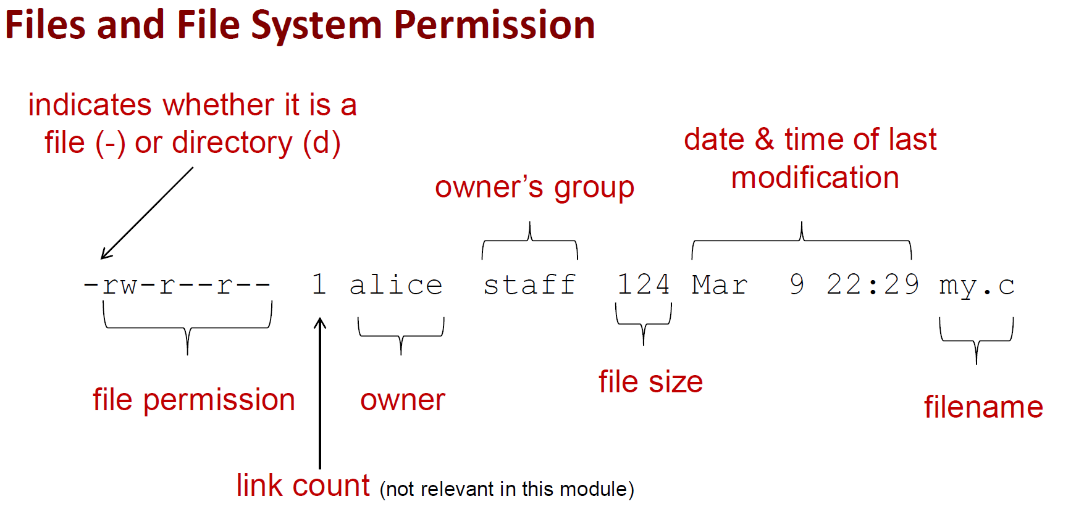
Recap - permissions
First rwx for user (u), second rwx for group (g), last rwx for others/world (o)

Slide 17
Privilege escalation
If setuid, setgid and sticky bit is activated e.g. [d rws rws rwt]
setuid – Elevate current user to owner’s privilege
== > If file belongs to root and you run it, any code executed in the file will be done with root’s privilege
setgid – Similar to setuid but only apply on group
Sticky bit – only the owner can delete the file
Note:
Permissions are not checked when running commands using `sudo`
Leading octal digit (when using chmod) to specify special file permissions
E.g. chmod 4765 <filename>

Slide 18
Backdoor program
Suppose an attacker, who is assumed to already have a local access, is given just a few seconds exercising your account. Can he plant a backdoor so that later he can come back to your account? The answer is yes.
He can run the following commands to set up a set-UID shell program:
$ cp /bin/sh /tmp/mysh
$ chmod u+s /tmp/mysh

Slide 19
Question B1
Suppose Bob was an unhappy system administrator, and had a root access on a system (i.e. he knew the root password). He was going to quit his job soon. Bob was very unhappy, and wanted to plant a backdoor into the target system. Let us assume that Bob would either still be given a local user, or knew the password of an existing local user, or alternatively had created a local user that would go unnoticed. Bob wanted to make a very small change to the system so that later, when he logged in as a normal user, he could still issue commands with root privilege.
Bob knew that his root password would be changed immediately after he left, and that his home directory would be erased. In addition, the new system administrator would also compare the system-level directories, such as /usr/bin, to make sure that no malicious changes had been made.

Slide 20
Question B1
Note:
The above-mentioned method of using set-UID probably can’t work in your favourite modern UNIX-based OS. This is because, due to the above security concerns, many OSes ignore the elevated effective UID when running shell scripts. This can be viewed as an “ad-hoc” patch to the security concern. Nevertheless, there are methods for Bob to work around it.
See, for example, http://koltsoff.com/pub/getroot/

Slide 21
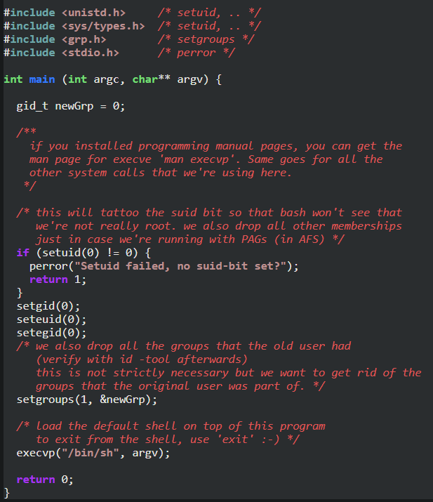
Getroot.c

Slide 22
Question B1
Instead of copying /bin/sh, as the root, Bob can just compile getroot.c to create an executable named stored in a hidden folder e.g. /games/pokemon/scores/removescores, and enable its set-UID bit.
As you can see, getroot.c first turns the current setUID process into a real root process by invoking, among others, setuid(0).
As explained in https://www.gnu.org/software/libc/manual/html_node/Setting-User-ID.html#Setting-User-ID , if the calling process is privileged, setuid(0) sets both the real and effective user IDs of the process to 0. Once both real and effective user IDs are set to 0, a shell /bin/sh is subsequently invoked.
As a result, when later Bob executes the planted executable as a non-root local user, he will obtain a shell running with a root privilege as planned!

Slide 23
Question b2
As usual, please google the term!
In B1, Bob is the insider threat.

Slide 24

Thank you
Any questions?

